Slide 1

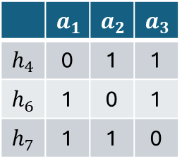


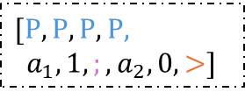
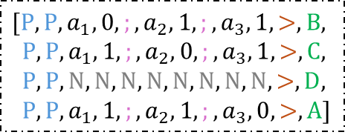


$$𝓗=\{h_{4},h_{6},h_{7}\}$$
$$0$$
$$1$$
$$C$$
hypothesis class
Transformer
 | $$a_{1}$$ | $$a_{2}$$ | $$a_{3}$$
$$h_{4}$$ | 0 | 1 | 1
$$h_{6}$$ | 1 | 0 | 1
$$h_{7}$$ | 1 | 1 | 0
$$[P,P,a_{1},0,;,a_{2},1,;,a_{3},1,>,B,$$
$P,P,a_{1},1,;,a_{2},0,;,a_{3},1,>,C,$
$P,P,N,N,N,N,N,N,N,N,>,D,$
$P,P,a_{1},1, ;,a_{2},1,;,a_{3},0,>,A]$
$[P,P,P,P$,
$a_{1},1,;,a_{2},0, >]$
context query
$$S_{K}=\left(x_{2},0,x_{1},1\right)$$
hypothesis prefix
hypothesis table
ICL sequence

